Slide 1
Customer Lifetime Value (CLV) Prediction for HelloFresh
Leveraging AI/ML to Enhance Customer Retention & Personalization

Slide 2
Why CLV Prediction Matters?
Understanding high-value customers drives better personalization.
Helps optimize pricing and marketing strategies.
Reduces customer churn by predicting behavior trends.
Enables data-driven decision-making for subscription businesses.

Slide 3
Key Insights from CLV Data
Order frequency & subscription length are top CLV predictors.
Customers with high email engagement stay longer.
Lower pause frequency correlates with higher retention.
Early purchase behavior helps estimate long-term CLV.

Slide 4
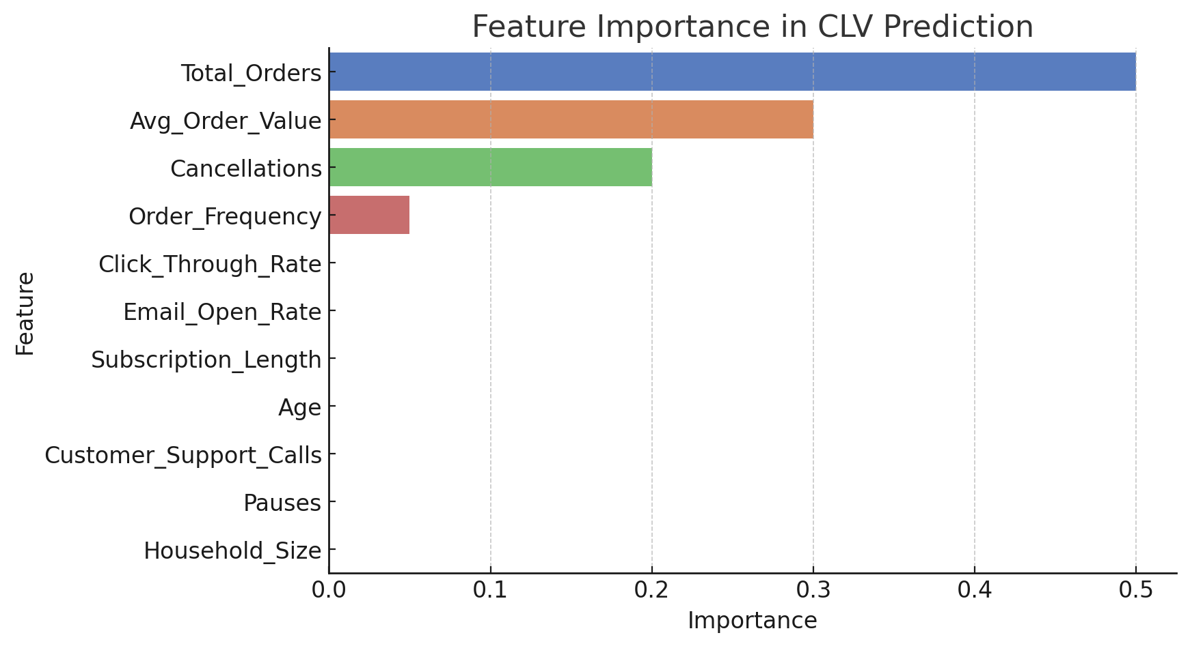
What Drives Customer Lifetime Value?

Slide 5
Business Recommendations for HelloFresh
Implement AI-driven meal plan recommendations.
Offer targeted promotions based on predicted CLV.
Adjust marketing spending to focus on high CLV customers.
Improve customer engagement via personalized experiences.

Slide 6
Next Steps for AI/ML at HelloFresh
Expand CLV prediction model with real-time data.
Develop automated churn prevention strategies.
Integrate CLV scores into CRM & personalization engines.
Test AI-powered customer engagement campaigns.

